Slide 1
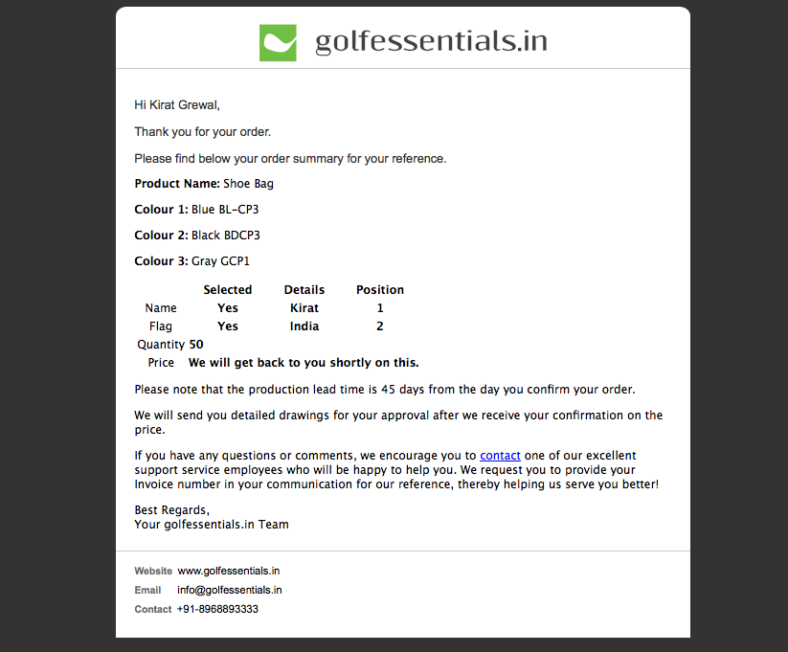
shortly
To be deleted in case of price on request

Slide 2
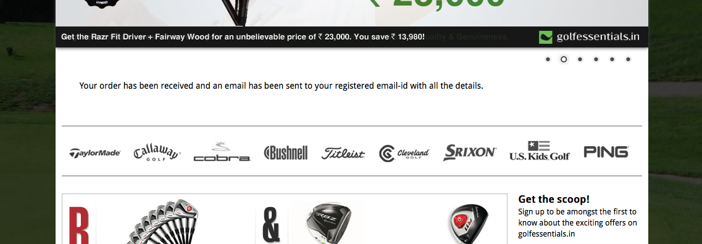
successfully placed
email ID with the order summary
ok

